Slide 1


The European Human Rights
Moot Court Competition
Pre-moots
LXVIII International Council Meeting, Batumi, 18-25th October 2015

Slide 2

The European Human Rights Moot Court Competition
What the Pre-moot is?
It is not elimination round – winner will not be qualified to the FOR
Finding suitable solutions for future expansion
Chance for teams to practice before the Final
Chance for teams which will not be qualified to the Final to experience the oral pleadings part
Cooperate with other Local/National Groups
Chance for National Groups to be involved in international project

Slide 3
The European Human Rights Moot Court Competition
What can be done?
Rules are binding
All the teams must be registered to ELSA International
All the teams must send their WS directly to ELSA International
Before or after the WS results
The best team will not go directly to the Final in Strasbourg
Still, only one team per University

Slide 4

The European Human Rights Moot Court Competition
Step by step
Promotion, information about the Round spread online
Inform your Local Groups, motivate them to create a team
Personal approach!
Get from VP MCC EI score sheets
The same Case, the same Rules – make it accessible
Research of potential Sponsors and Judges
Prepare presentation of the project, offer, oficiall invitation to serve as a Judge, press release, documents for honorary patronage
Create budget

Slide 5
The European Human Rights Moot Court Competition
2/3 months before the event
Time for Local Groups to find teams
Official invitation to Judges, provide them with guidelines
Book pleading venues
Cathering
Accommodation, if provided
Search for prizes

Slide 6
The European Human Rights Moot Court Competition
After 15th of November
You know exact number of teams, which sent their Submissions to ELSA International
Provide teams with all needed information regarding the Round
Finalize the pleading schedule
Print materials
Prepare the OC schedule for the Round
Brieding for the OC
Training for Timekeepers
Finalize social programme

Slide 7
The European Human Rights Moot Court Competition
Oral Pleadings
Teams plead on both sides - Applicant and Respondent, Applicant on the rights side of the Jury
Brief the Jury
The Jury has to consider the following points while scoring the oral pleadings: weighing of legal issues, argumentation (logic, reasoning), legal analysis (law, treaties, analysis and application of it), style (grammar, organization of arguments), teamwork, answering to judges questions.

Slide 8
The European Human Rights Moot Court Competition
The Chairman of the Jury will welcome the teams
Teams introduction
Applicant – 35 minutes time
Respondent – 35 minutes time
The Jury may ask questions during these pleadings at any time and number
It is up to the jury’s discretion whether a team shall be granted additional time when requested.
Applicant - 5 minutes to present the rebuttal (according to what the respondent presented)
Respondent - 5 minutes to present the sur-rebuttal on the just stated arguments from the applicant

Slide 9
The European Human Rights Moot Court Competition
The Pleading sheets
The Team Appearance Sheet
Give 1 to each team and let them fill it out immediately
Then fill in the names from the appearance sheet into the score sheets for the Judges (2 for each Judge – applicant, respondent)
b) The Score Sheet
Each Judge has to receive 2 Score Sheets – one for the Applicant and one for the Respondent (with the names of the teams filled out by you)
They have to be signed

Slide 10
The European Human Rights Moot Court Competition
c) The Timekeeper Sheet
The timekeepers need 2 timekeeper sheets
Fill in the names of the participants pleading and not pleading
Fill in the minutes they said they will be speaking
Minute the time – show the time cards and count the time (25,20,15,10,5,3,2,1,TIME) – use the second page of the timekeeper sheet as orientation
Count the questions from the Jury in the time per team, do not stop the clock
Afterwards fill in the actual main pleading time
Fill in the time of the rebuttal/sur-rebuttal
Sign the timekeepers sheet

Slide 11
The European Human Rights Moot Court Competition
National Rounds in the Network

Slide 12
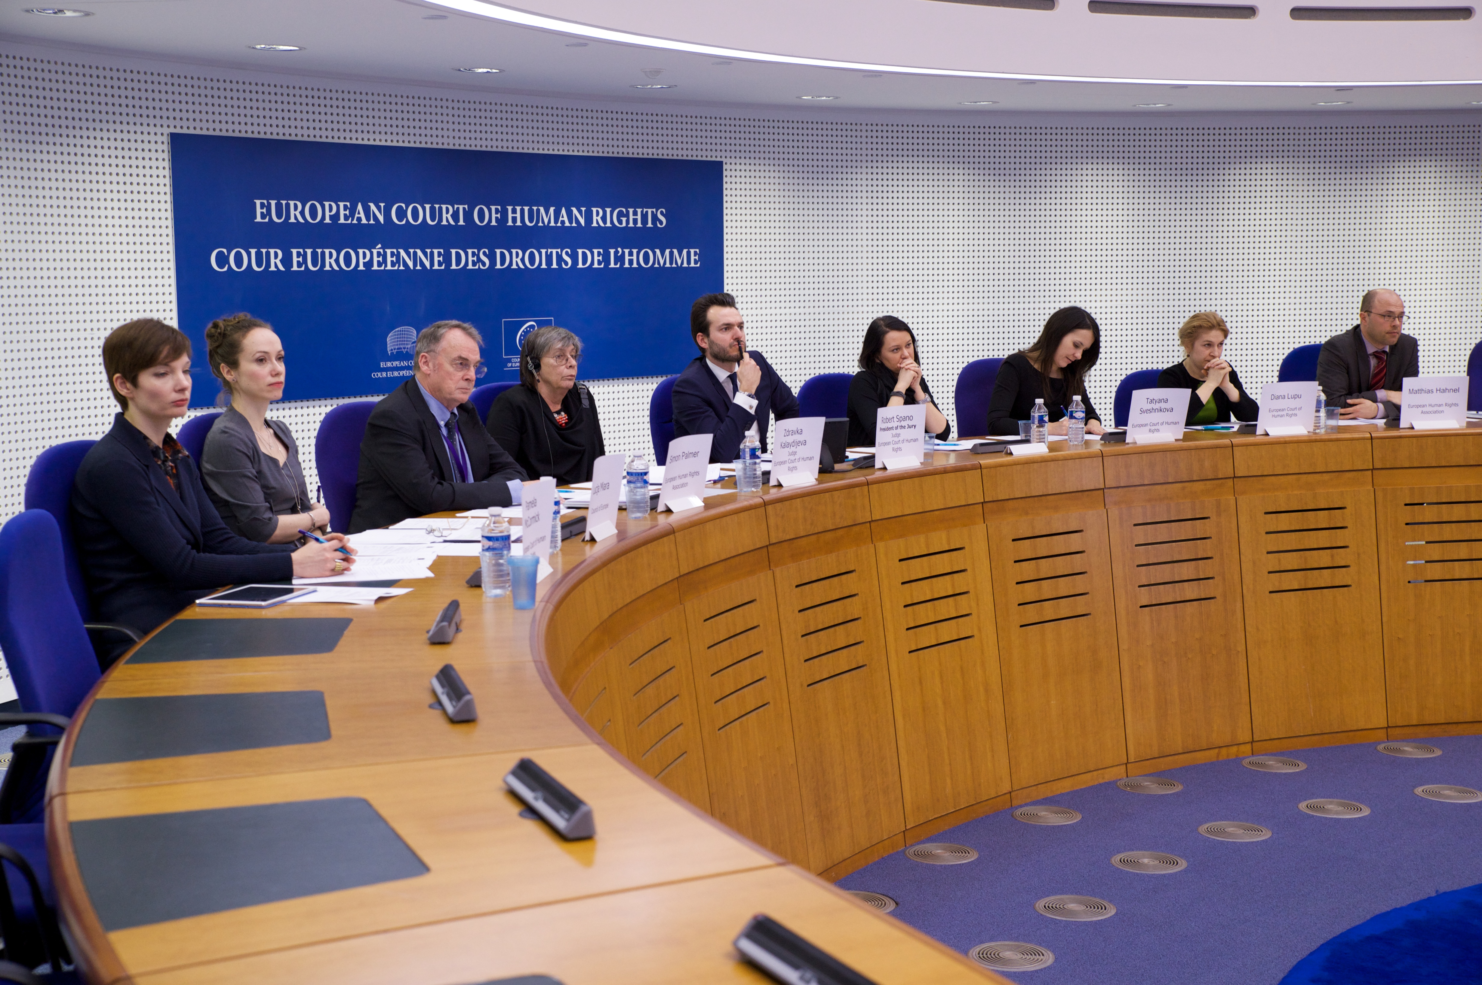
The European Human Rights Moot Court Competition
Discussion: pre-moots,
is it a way to go?

