Slide 1

ICM Batumi, 18th-25th October
AA Workshop
Legal Research Groups

Slide 2
What does LRG stand for?
Decision Book – AA part
Legal Research Group is the group which does research on a specified topic of law with the aim to make their conclusions publicly accessible.

Slide 3
The difference is clear:
LRG
Law School
assignments

Slide 4
Law School assignments
+Gaining knowledge
+Doing legal research
+Exercising legal writing
+Demands less time
-
-
-
-
-
-
-
-
ELSA Legal Research Group
+Gaining knowledge
+Doing legal research
+Exercising legal writing
+Long and productive research
+Stated as International Publication at your CV
+Organised by ELSA and CoE
+Certificate signed by CoE
+Report on the official website of CoE
+Invitation to conferences as speaker
+International teamwork
+Practice English legal terminology

Slide 5
Recent LRG history
ELSA for Children - 2012
Online Hate Speech - 2013
Children Rights – 2014
Social Rights - 2015

Slide 6


Slide 7


Slide 8


Slide 9


Slide 10
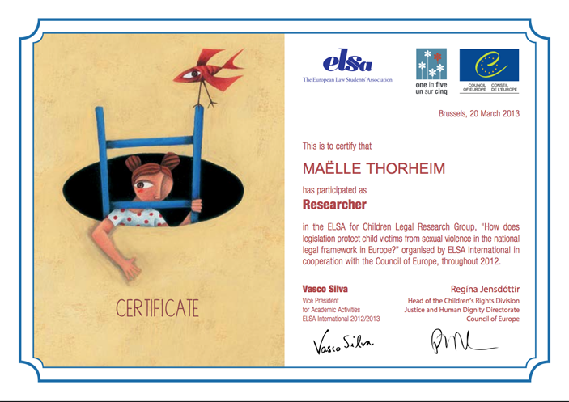
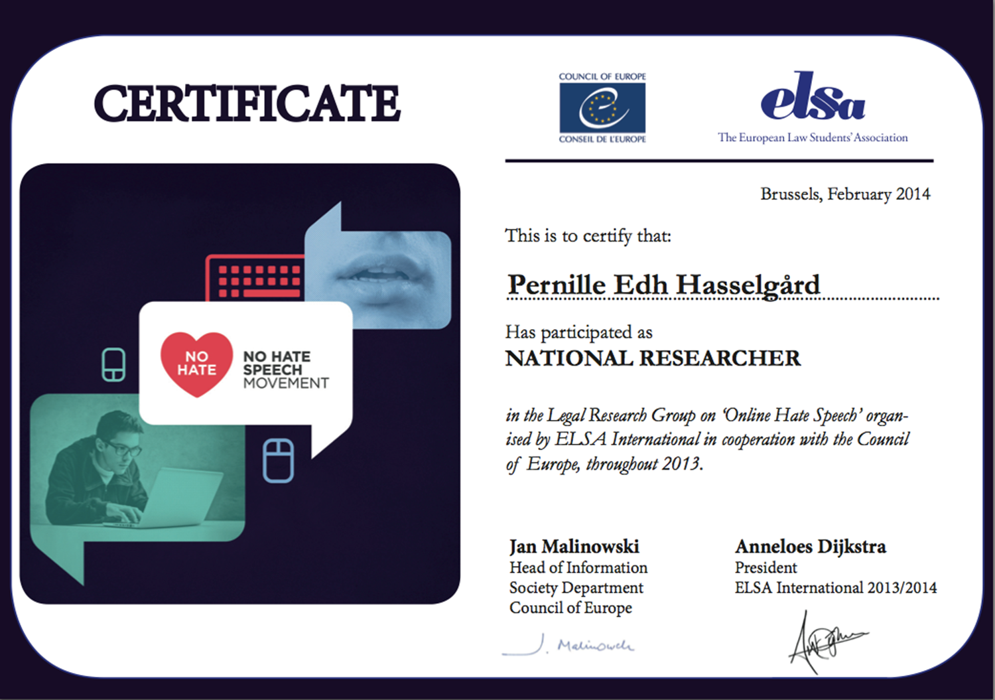
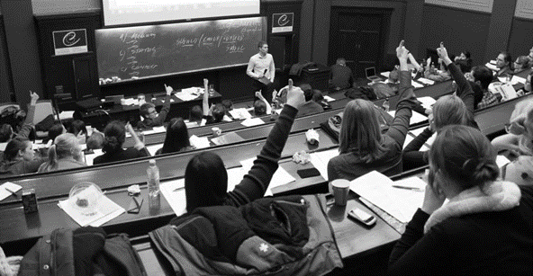
Opportunities

Slide 11
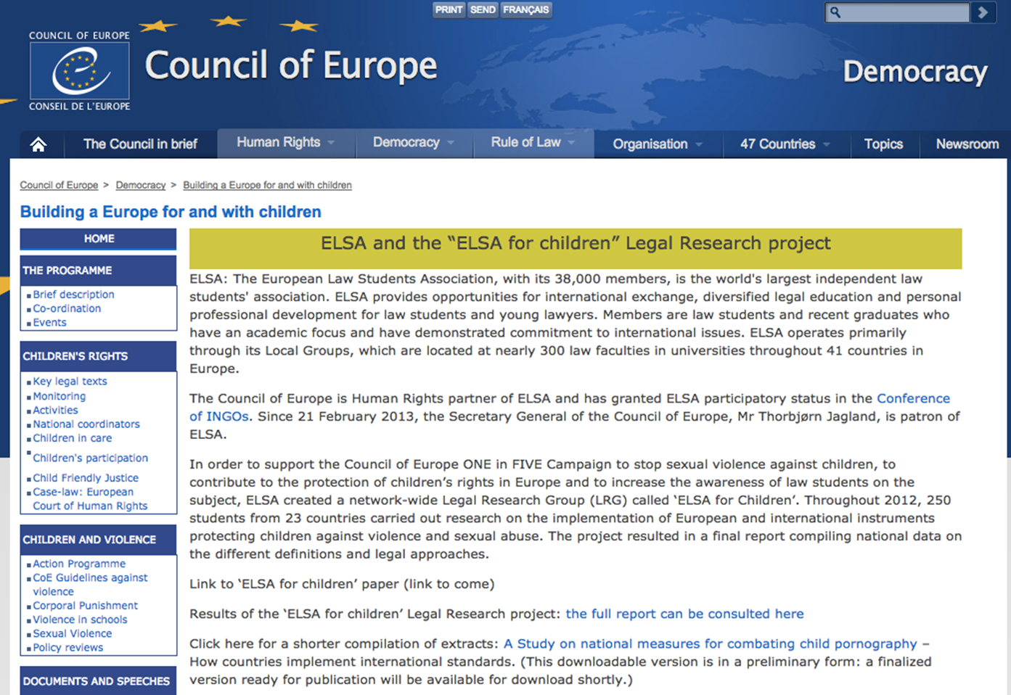

Slide 12
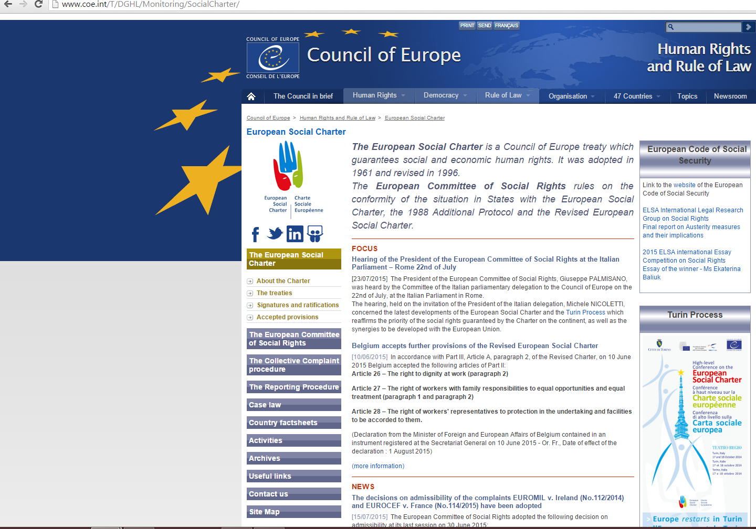

Slide 13

Following up:
Concluding LRG conference
Strasbourg, 30th Nov.-5th Dec. 2015 www.lrgconference.org

Slide 14

New LRG 2015/16
*In cooperation with: CoE – Media and Internet Division
*General theme: Freedom of Expression
*Special topic: Protection of Journalists

Slide 15
How can you contribute?

Slide 16
ELSA & Council of Europe
International Coordination Team
National Coordination Teams
Researchers

Slide 17
ELSA & CoE
Definition of the topic – Promotion strategy
ICT
Overall coordination of the National Teams
Academic support, technical contribution
NCT
Recruitment
Link for ICT and researchers
Researchers
Research and report

Slide 18
}
International Coordinator
International Academic Coordinator
International Human Resources Coordinator
International Linguistics Editor
International Technical Editor
ICT
+ International
Academic Advisor
The first pieces of the puzzle

Slide 19
}
National Coordinator
National Academic Coordinator
National Academic Advisor
National Linguistics Editor
National Technical Editor
NCT
More pieces of the puzzle

Slide 20
ELSA wants you to participate!
Share the word, make the research, write the word, get cited.
This is legal writing, this is a legal triumph!

Slide 21
Challenges
Academic framework
Size
Deadlines
Publication
Financial support
Academic quality
Language
Human resources
Conclusions

Slide 22
Come up with a topic
Approach an expert (professor etc)
Define the exact topic and create an academic framework
Create promo materials
Recruit people
Set timeline for the draft report
Comments and feedback
Final report – compliling - publication
Follow up activity

