Slide 1
International Focus Programme
KAM Bratislava 2017

Slide 2

Why IFP?
Regulations
Unified branding
Guidelines
+ Rebranding?

Slide 3
What about the environment?
Notes:
Watch https://www.ted.com/talks/zaria_forman_drawings_that_show_the_beauty_and_fragility_of_earth

Slide 4
So umm. What about us?
Notes:
Watch https://www.ted.com/talks/zaria_forman_drawings_that_show_the_beauty_and_fragility_of_earth

Slide 5
A voice to law students and young lawyers
Bring attention to a forgotten topic
Reassert the primary goals of ELSA

Slide 6
What is the situation now?
Total 40 Events
Czech Rep : 4
Estonia: 1
Finland: 7
Sweden: 6
Greece: 1
Italy: 7
Malta: 1
Norway: 1
Poland: 3
Romania: 4
Spain: 1
Turkey: 1
Ukraine: 2

Slide 7
So what’s the future of IFP?

Slide 8
How can we do it?

Slide 9
1ST Year of IFP
March 2017 – August 2017
  Host IFP week in April throughout the whole of the Network to increase the IFP awareness. In this week each Local Group should prepare several IFP events.
  Use IFP week Events reports and the results of the events in publications on all levels.

Slide 10
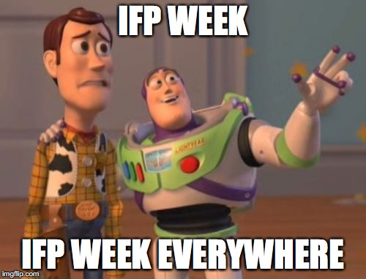

Slide 11
2nd Year of IFP
September 2017 – February 2018
  Liaise with universities to engage them further in all IFP related activities.
  Continue with publishing IFP related articles in publications.
  Organise international projects focused on IFP.
  Raise members’ awareness of the foreign aspects of Environmental Law via Study Visits.
  ELSA International is to establish a Legal Research Group on IFP.

Slide 12
2nd Year of IFP
March 2018 – August 2018
  Host the second IFP week in April.
  ELSA International is to designate one Local or National Group to organise the Mid-IFP conference.

Slide 13
3rd Year of IFP
September 2018 – February 2019
  Focus the Moot Court Competition topics on IFP.
  ELSA International is to conclude the Legal Research Group and publish the outcome.
  Engage partners, speakers, participants, and former ELSA officers, who were in charge of the IFP, in order to discuss the impact of the programme on the development of Environmental Law.

Slide 14
3rd Year of IFP
March 2019 – July 2019
  Host the final IFP week in April.
  Produce summaries and reports of the IFP related events of the past 3 years in various forms.
  Provide ELSA International with evaluation reports and articles.
  ELSA International is to designate one Local or National Group to organise the Final IFP conference to conclude the cycle.

Slide 15
Topics:
Why hasn’t IFP been successful so far?
What can we do to make it successful? #revamp
What can we do together to raise awareness aout the IFP among ourselves at the ICM?

