Slide 1
International Conferences of ELSA I
IX KAM, 4-8 September 2019
Istanbul, Turkey

Slide 2
Know - how
2
Days+
In
English
10h+
of Scientific programme

Slide 3
Let’s talk about money, money, money
  35 euro – non-favoured
  30 euro – favoured
  50 euro – Gala Ball

Slide 4
Let’s talk about money, money, money
Scientific and social programme;
Lunch;
1+ coffee break;
Welcome package;
Administrative costs.

Slide 5
Plan for the next months
October | November
Logo | First promo
Branding | Call for SPF
Website | Coaching
Templates | Partners’ meetings
ICM proposals

Slide 6
ICM proposals
Quality standards
Responsibilities of EI and OCs
Specification and Evaluation
Any inputs?

Slide 7
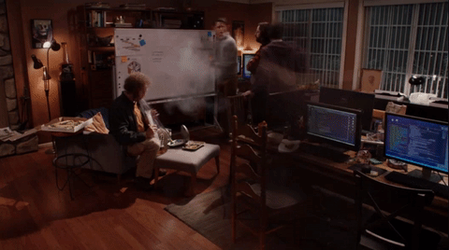
Is it possible to organise ICE in your LG/NG?

