Slide 1
Promoting S&C Activities
KAM Münster

Slide 2

Well, let’s be honest we all know whats best for S&C.

Slide 3
Channels
Web-pages
  International events – ELSA International
  Local/National events – LG/NG
Facebook
  The most successful channel
Mailing list
Posters/leaflets
  Small reach
  Only on a Local level
Synergy calendar or article
Linkedin
Twitter
Snapchat
Promotional Videos

Slide 4
Which information to share?
Focus on the following –
  Why to attend?
    Certificate of participation
    Well-known speakers
    Foreign guests
    Interesting and unique topic
    Prize
  What is special about your event?
Do you have any tips or tricks?

Slide 5
Web pages of ELSA International
http://elsa.org
  Promote international ELSA events
  ELSA International Calendar
  6 other flagship web-pages
http://officers.elsa.org
  Not used for promotion
S&C related web-pages
  http://lawschools.elsa.org
  http://delegations.elsa.org

Slide 6


Slide 7
Facebook
Suitable Materials
  Square images
  GIFs
  Cover photo (851x351px)
  Videos
  Hashtags
Events
  Is seen only by the invited audience
Fan-pages
  Very small reach without personal sharing or advertisement
Groups
  Local area officers, national members, local members, law-course

Slide 8
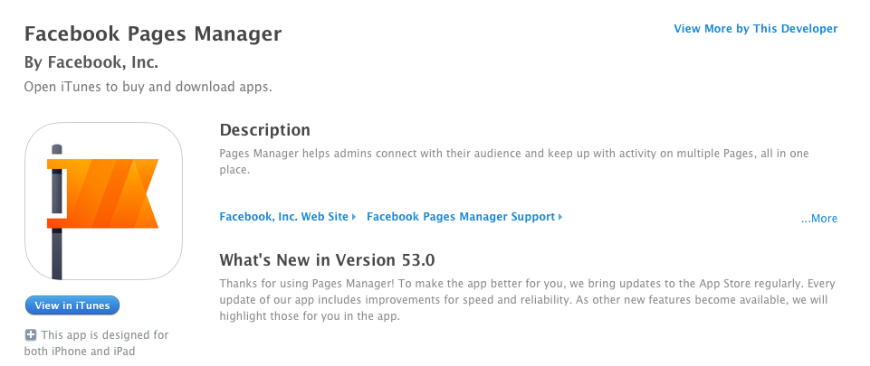
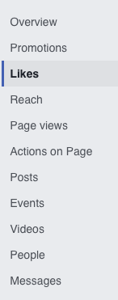
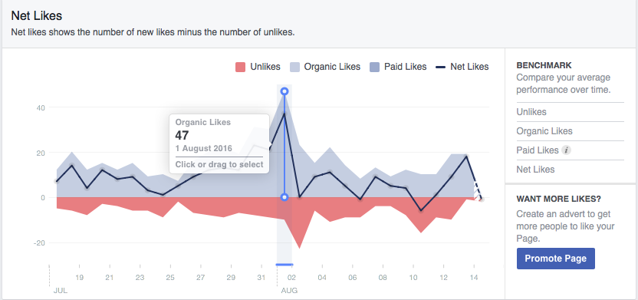
Facebook Pages

Slide 9
Facebook Advertisement
Targeted audience with a good reach
  Basic reach is approximately 10,000 users
  Target the marketing campaign
When?
  Most suitable for international events or big national events
  Worth to use it when the participants pay a fee for an event
How much does it cost?
  Approx. €5 per day

Slide 10
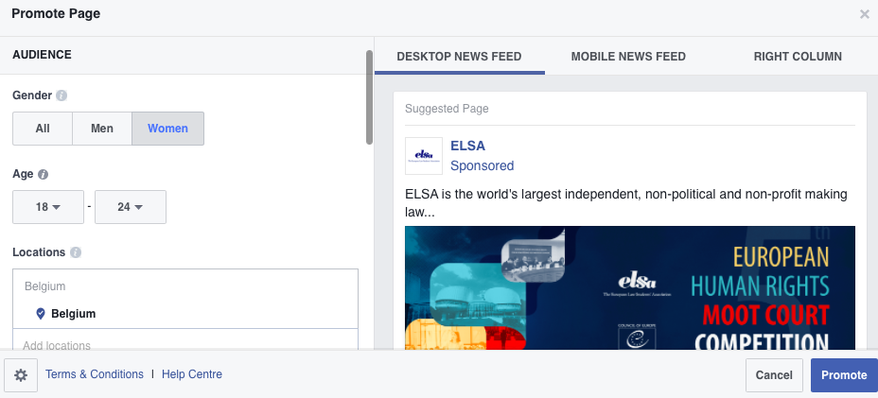
Facebook Advertisement

Slide 11
Working Groups
How would you promote a project? (20 minutes)
  Plan a promotion campaign
  Presenting to a fresher
    An International Conference organised by your LG/NG
    ELSA Law School
    ELSA Delegation
    An IFP related event
    An ELSA Webinar
Presentations by Working Groups (15 minutes)

